Slide 1
SDUMarket
(INF 232 final project)
Token Bauyrzhan

Slide 2

Let’s just you need to buy or sell your product
Use SDUMarket then
SDUMarket

Slide 3
About the app
Messenger management application: create rooms, add topics and type question
associated with the topic of this room

Slide 4
History of app
create url’s & views
create templates
CRUD operations in views
Search function
User login, logout, create users
Add flash messages
Add requirements before CRUD
Divide some pages(for use them in another pages)
Static files

Slide 5
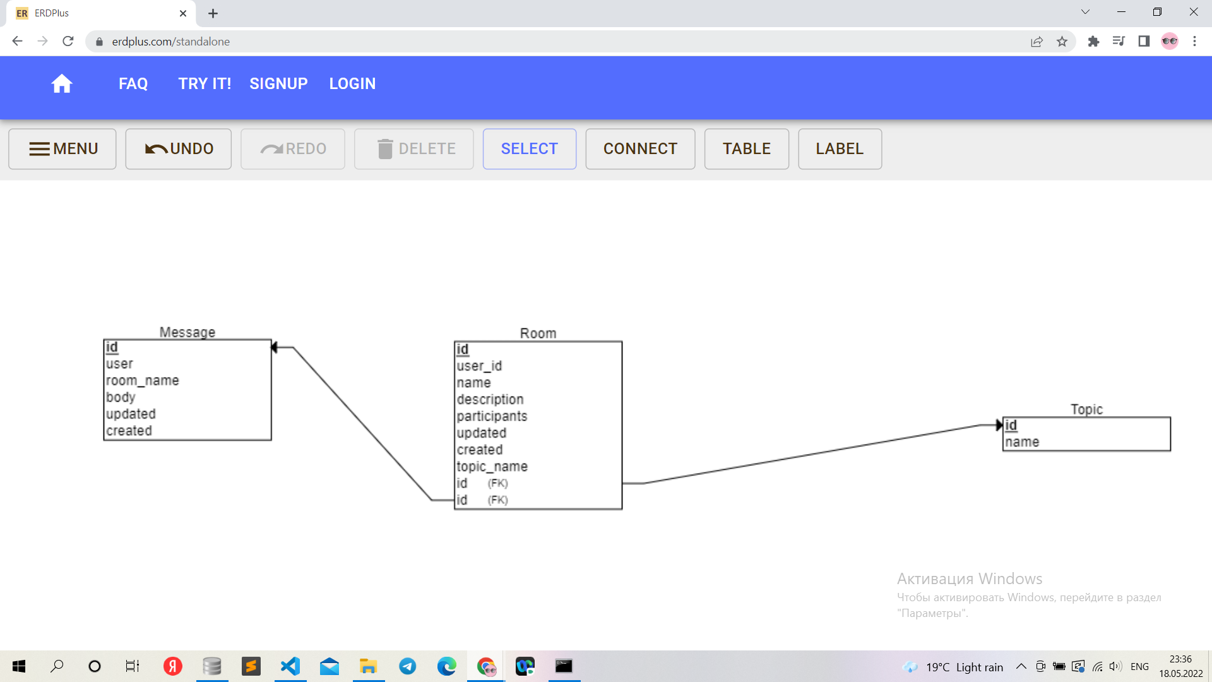
Diagram of Models

Slide 6
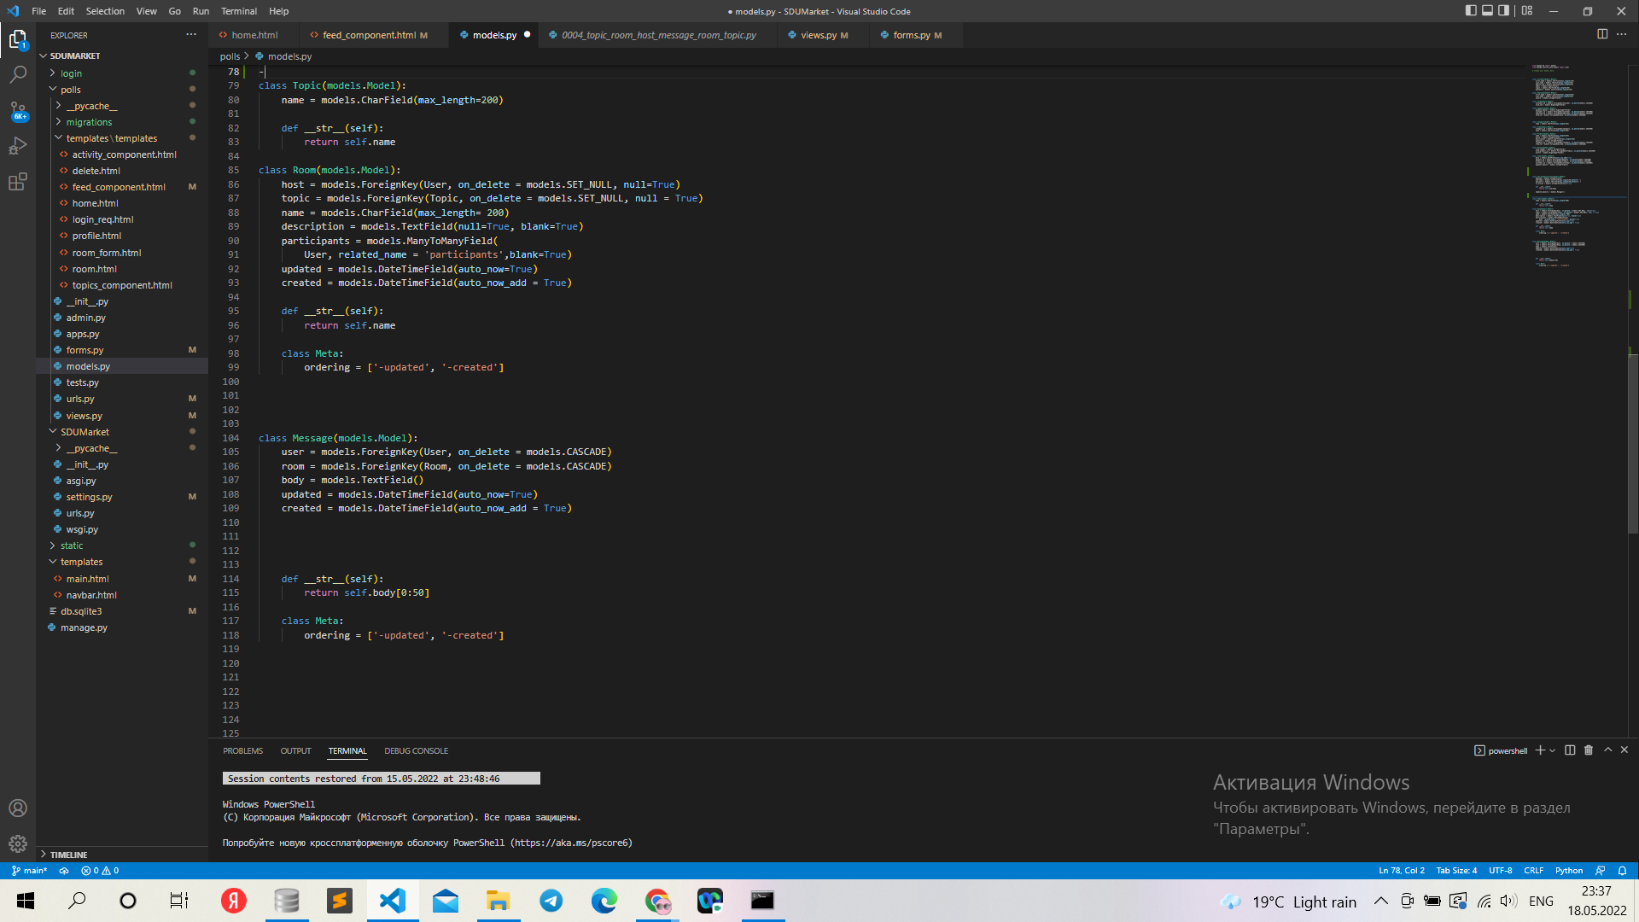
Diagram of Models in models.py

Slide 7
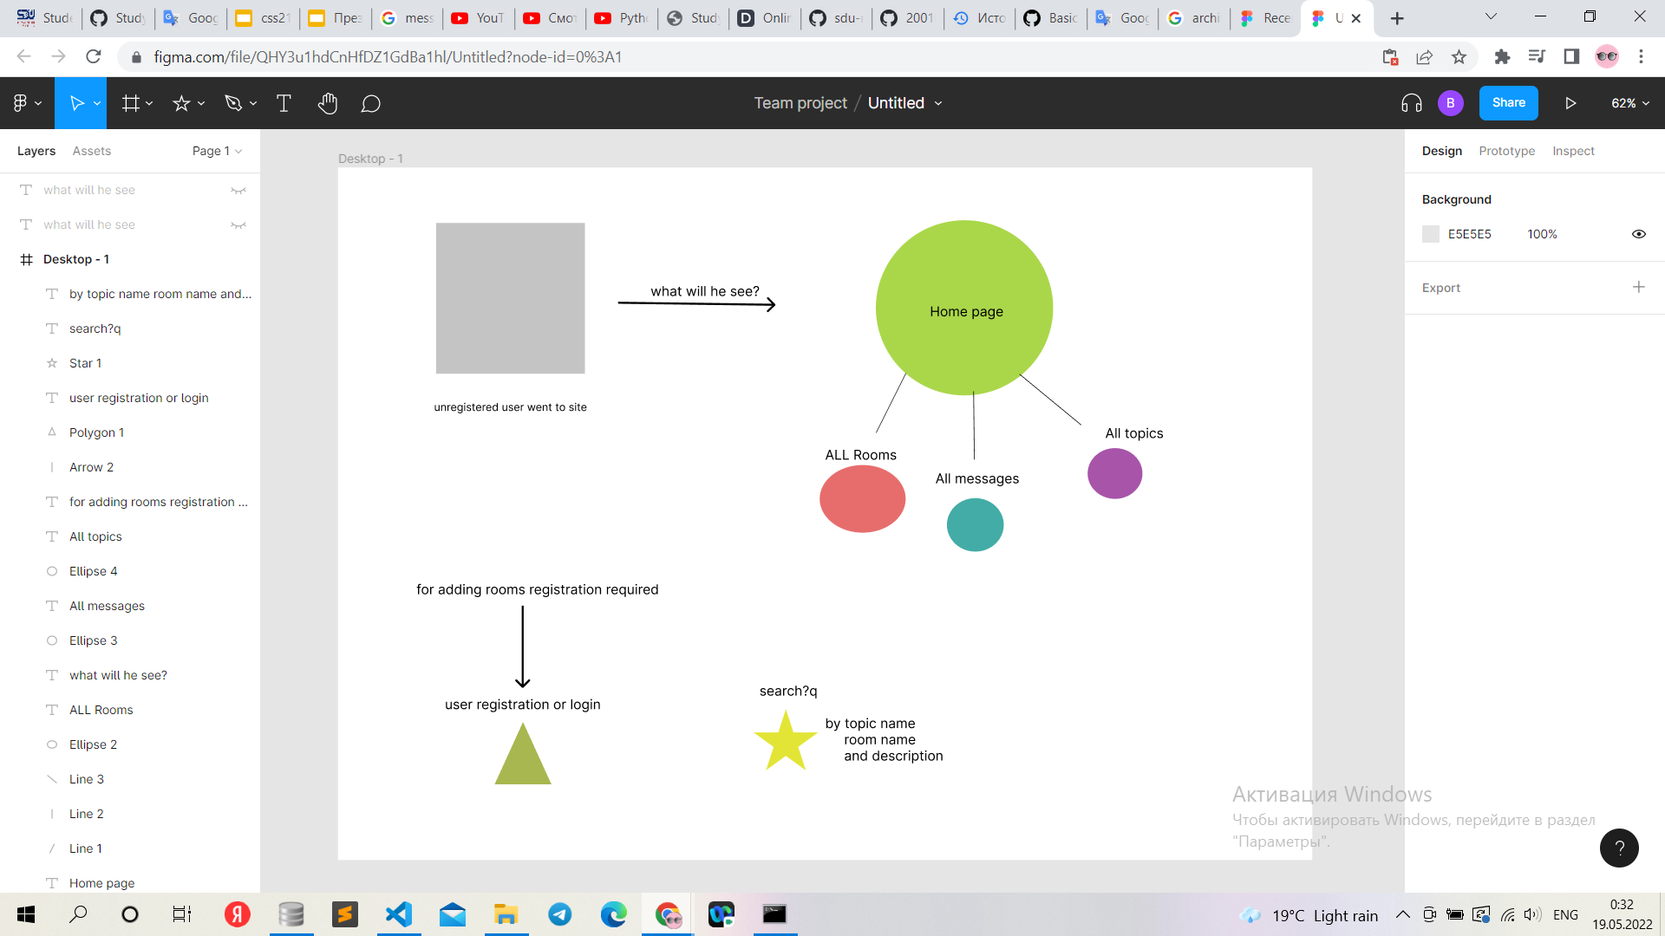
Functionality

Slide 8
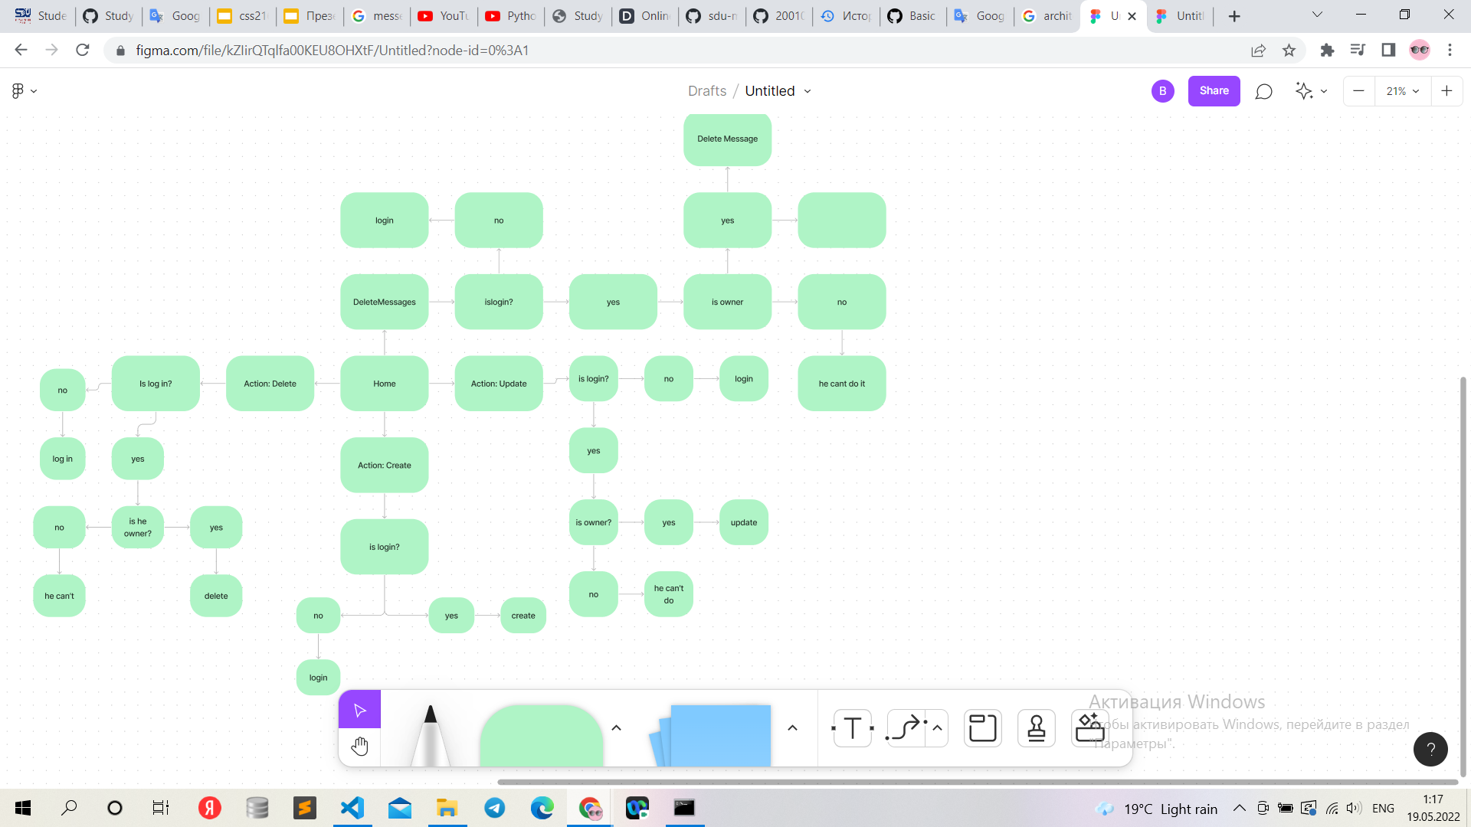
requirements for CRUD

Slide 9
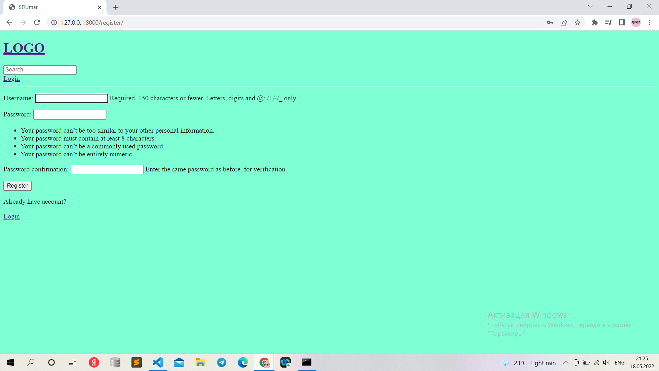
User login,logout,create user

Slide 10
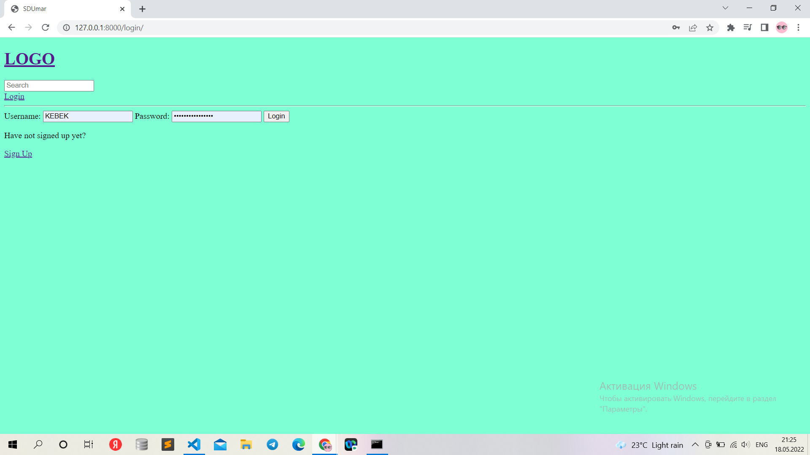

Slide 11
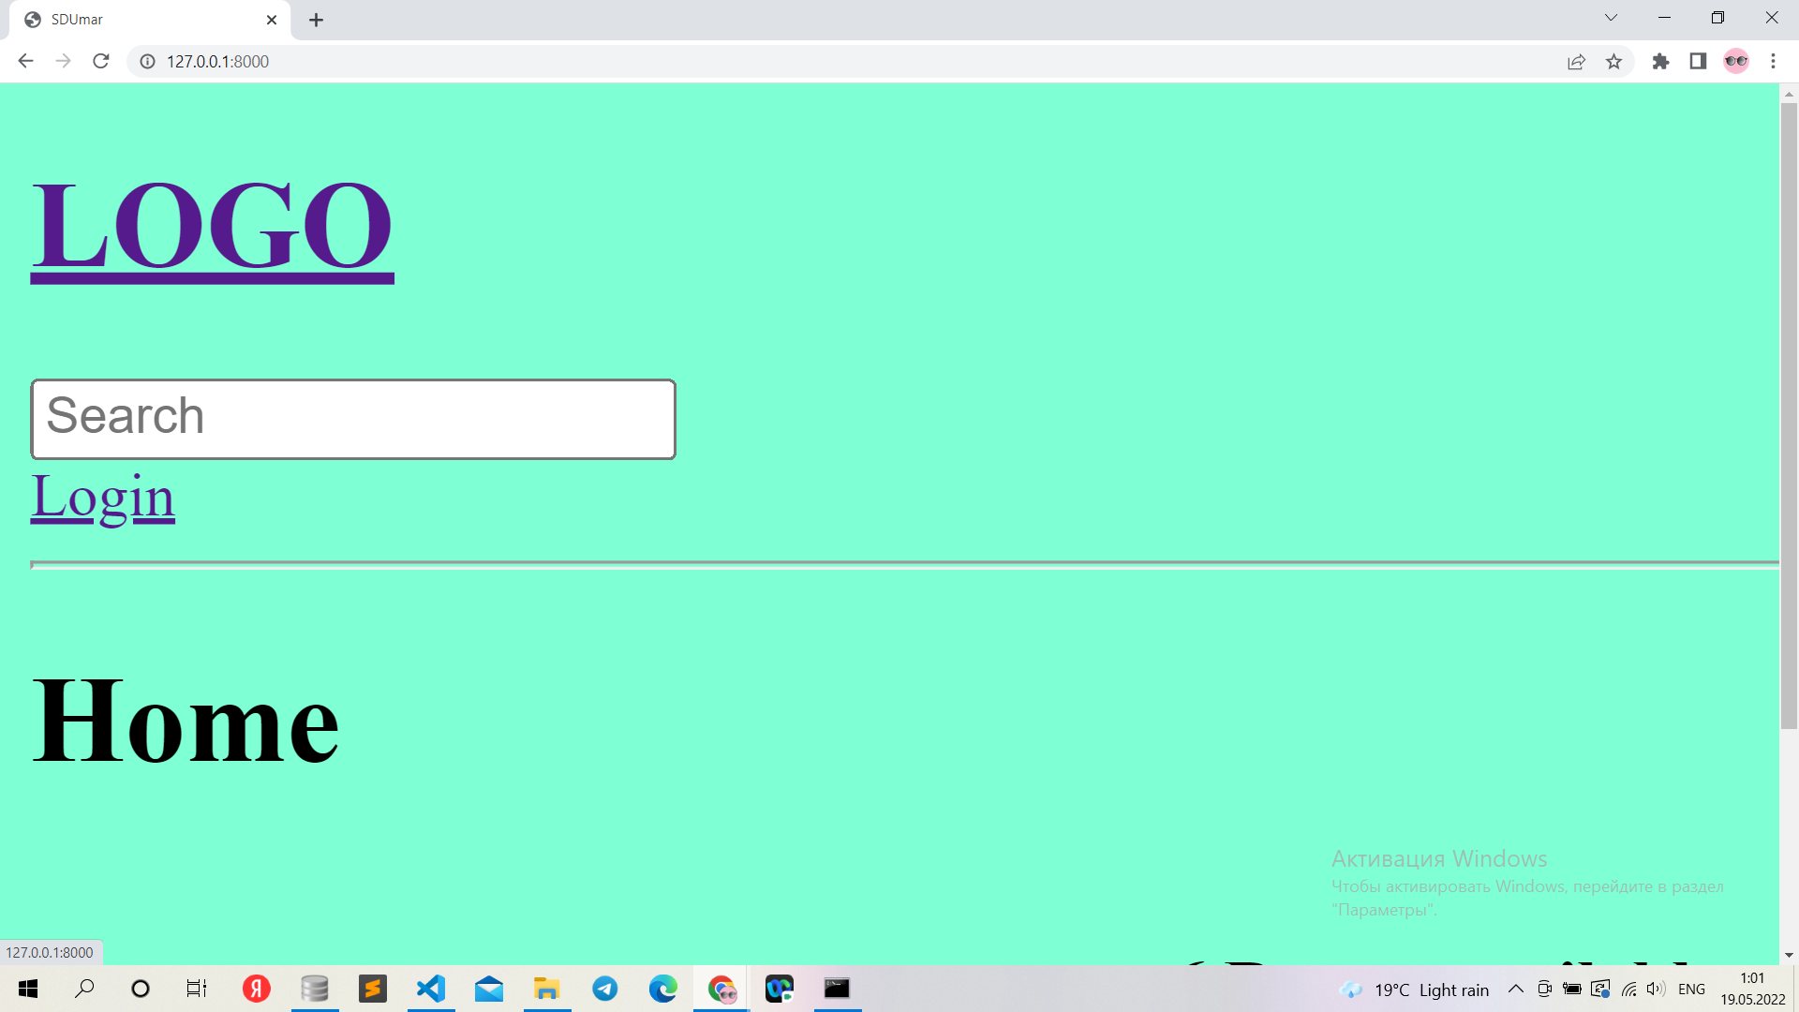

Slide 12
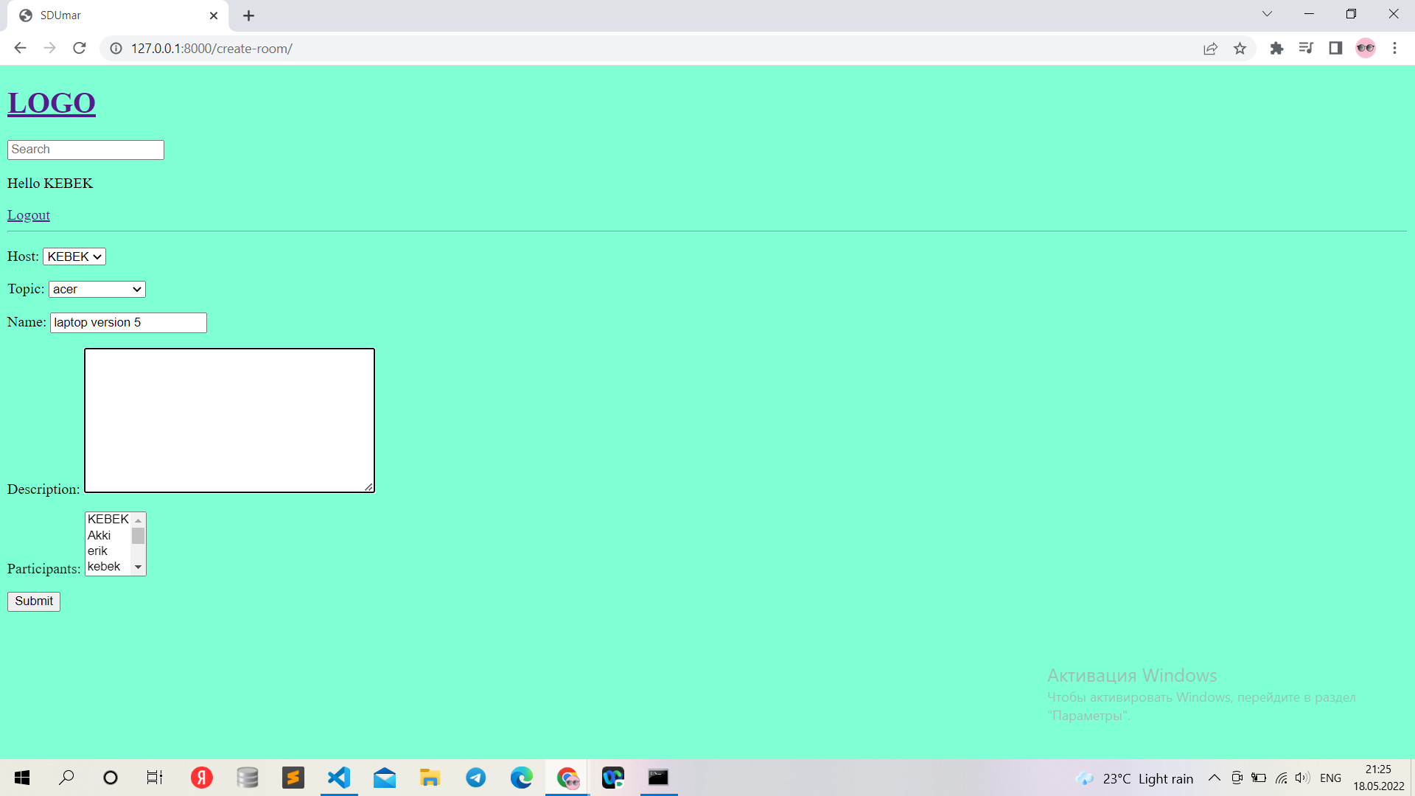
Create, delete, update room

Slide 13


Slide 14
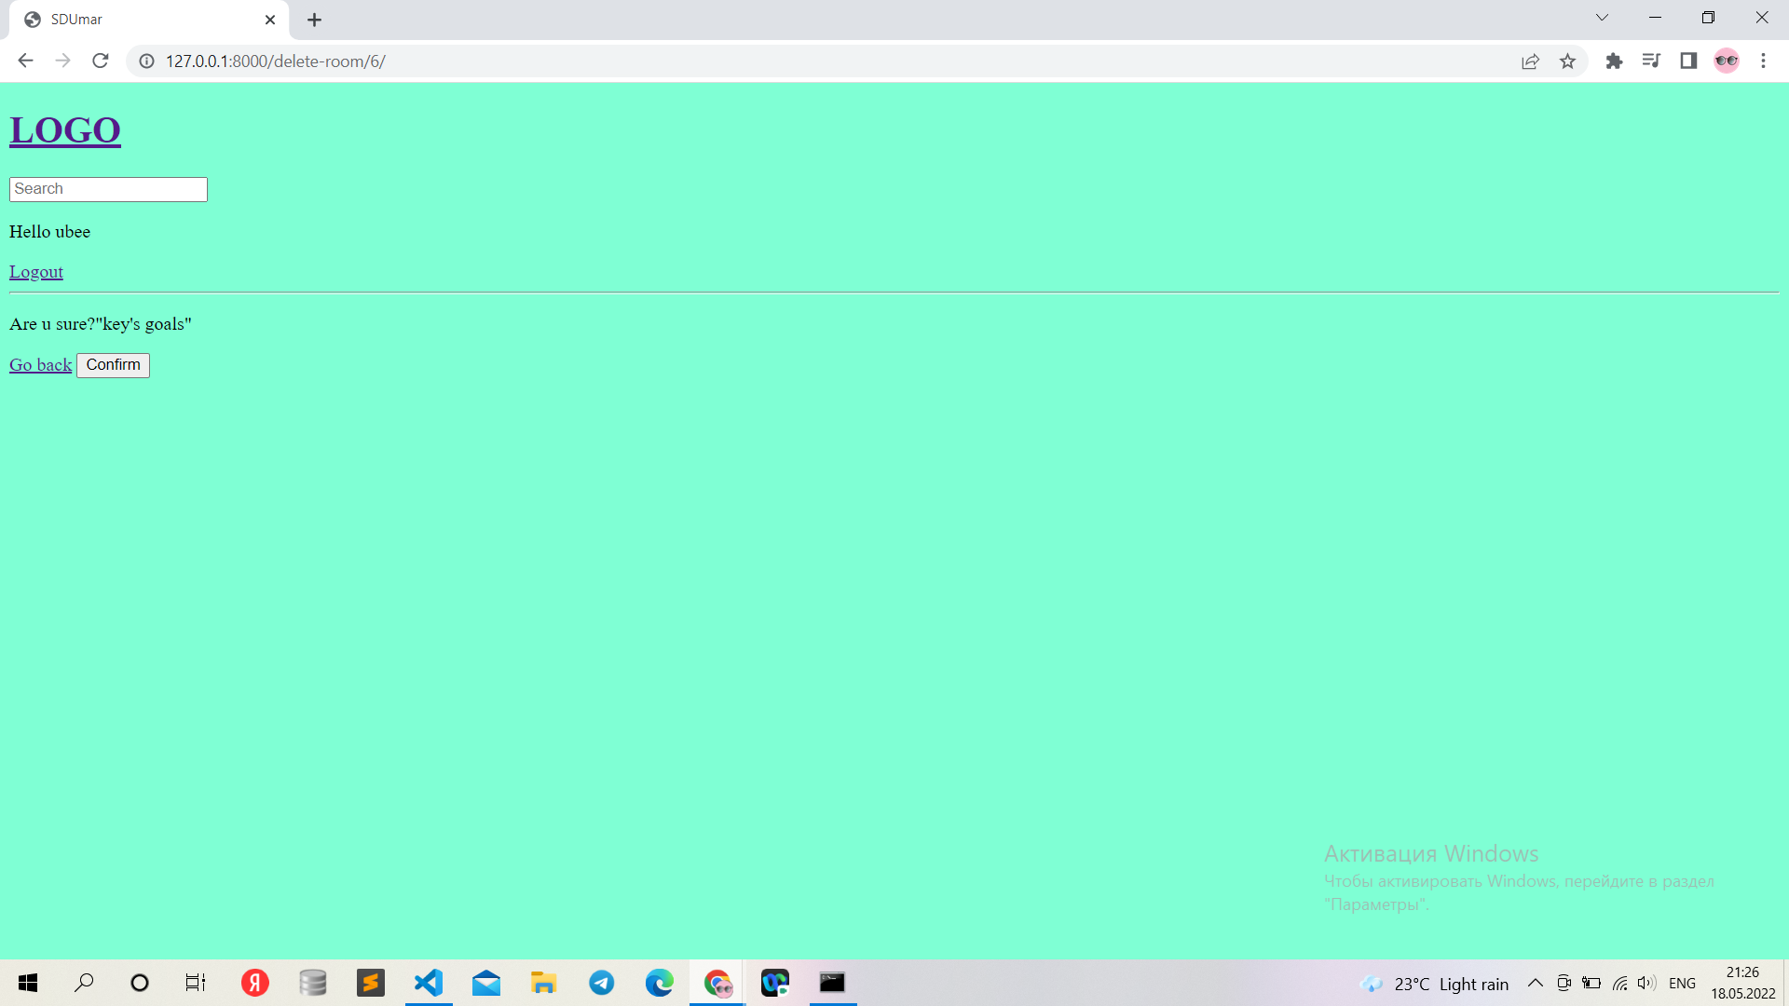

Slide 15
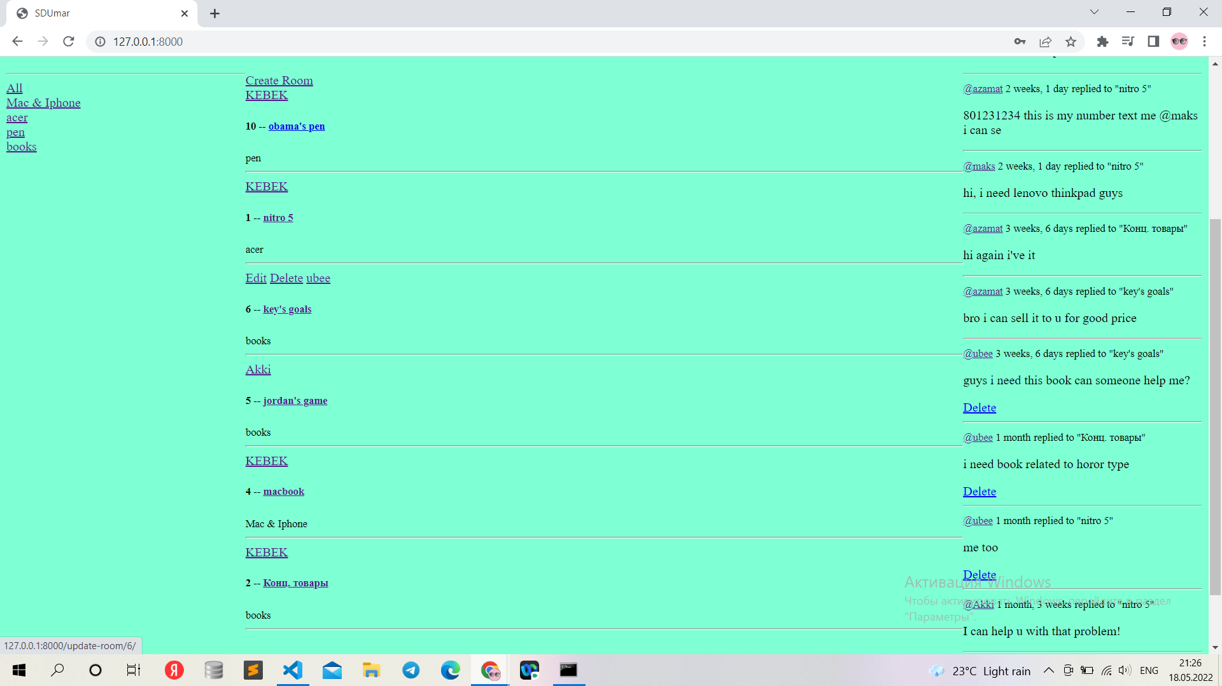
update delete in template

Slide 16
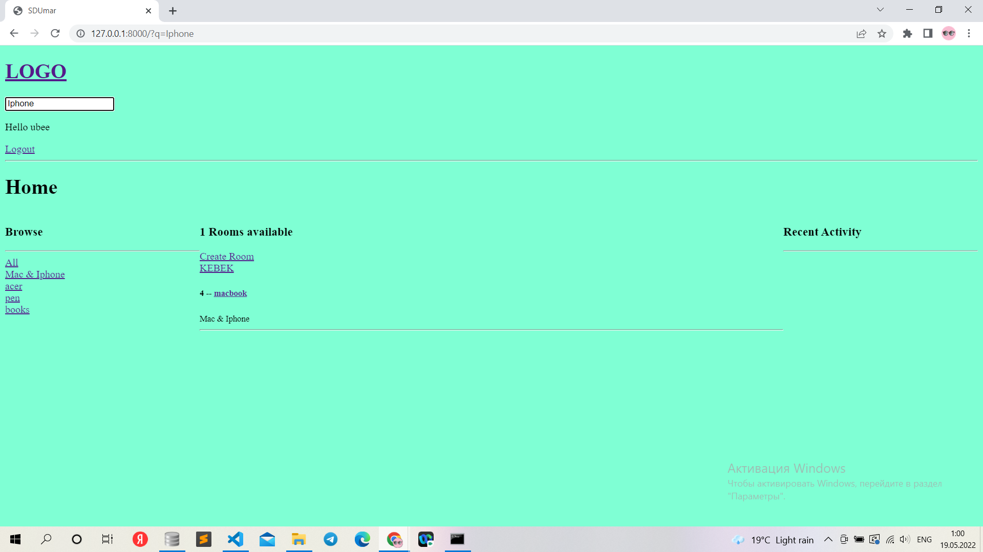
Searching

Slide 17
Thank you for your attention!
Feel free to ask any questions!

